Slide 1


Natural Language Processing Tutorials
Become a natural language processing expert
Supervised by Dr. Kenny Zhu
TAs: Essam Abdelghany

Slide 2
Pop Quiz
Reminder in tutorials we recap on lecture via pop quiz, learn technologies discuss hard problems in assignments, demonstrate practical aspects of content learnt in lecture

Slide 3

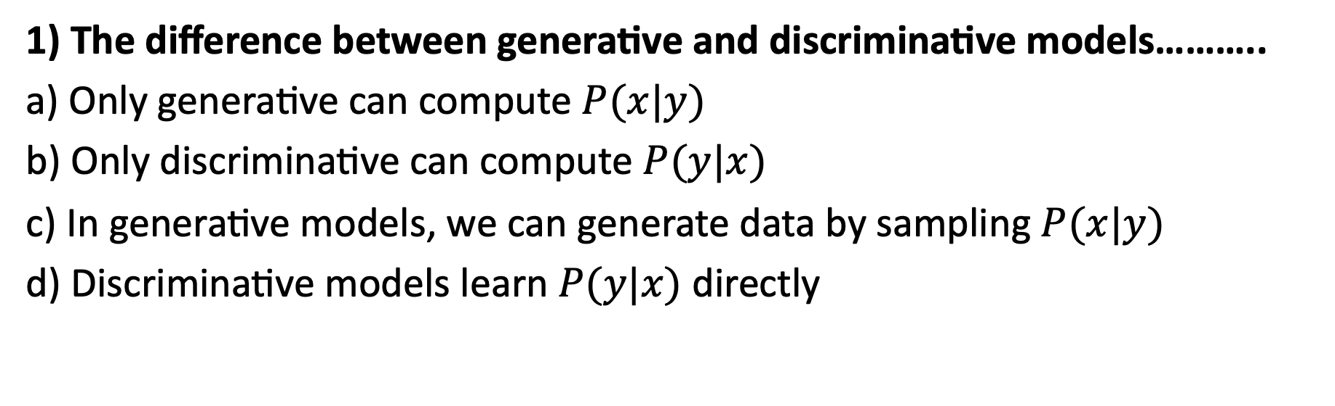
Pop Quiz
1) The difference between generative and discriminative models………..
a) Only generative can compute $P(x|y)$
b) Only discriminative can compute $P(y|x)$
c) In generative models, we can generate data by sampling $P(x|y)$
d) Discriminative models learn $P(y|x)$ directly
Take notes as quizzes may not be posted in solved form.

Slide 4
Pop Quiz
2) The number of parameters in logistic regression…
a) Generally depends on the size of vocabulary
b) Is equal to the number of features plus one
c) Is quadratic in terms of the number of features
e) Depends on the underlying logistic network

Slide 5
Pop Quiz
3) In logistic regression, we must………..
a) Represent each document by a numerical vector
b) Extract numerical features from the document
c) Compute probabilities for all possible bigrams
d) None of the above

Slide 6
Pop Quiz
4) Assumptions made by logistic regression………..
a) Conditional Independence
b) Sequence Irrelevance
c) Any assumptions made by the features
d) Linearity of the feature space

Slide 7
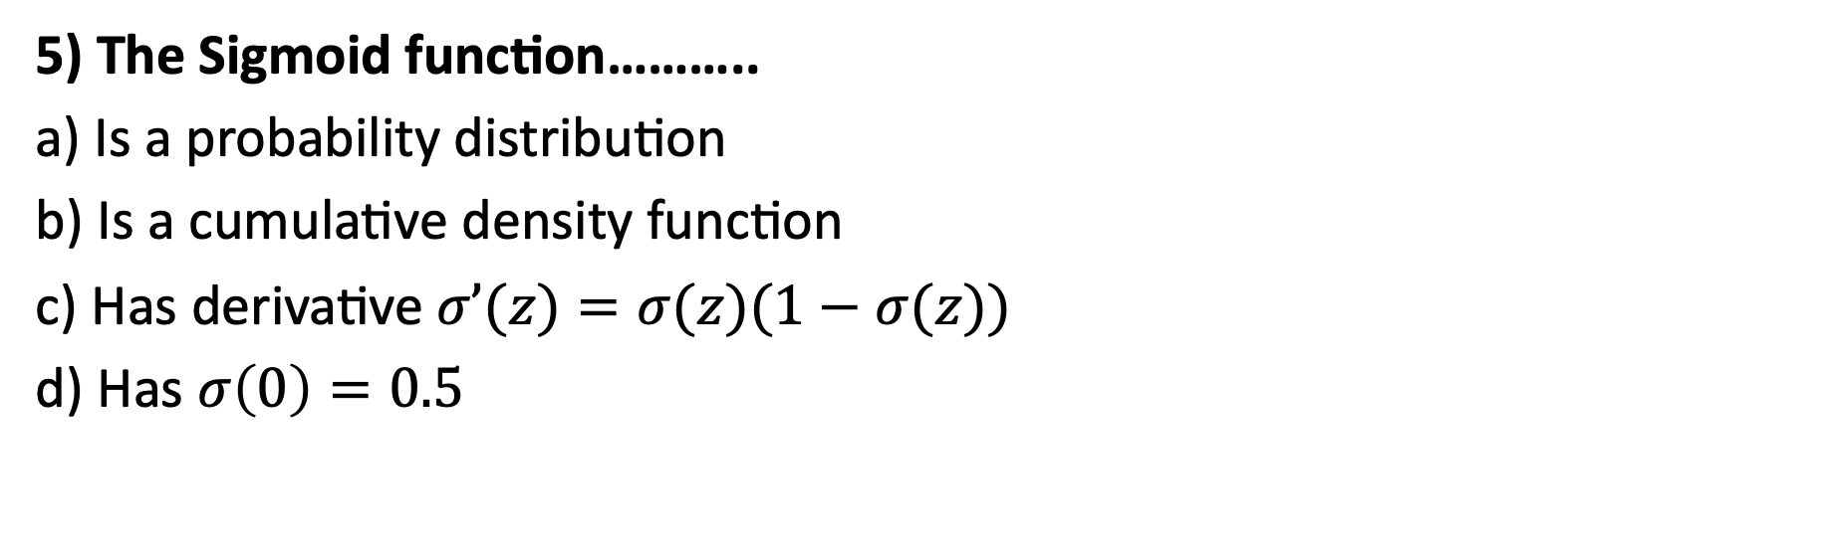
Pop Quiz
5) The Sigmoid function………..
a) Is a probability distribution
b) Is a cumulative density function
c) Has derivative $σ’(z)=σ(z)(1−σ(z))$
d) Has $σ\left(0\right)=0.5$

Slide 8
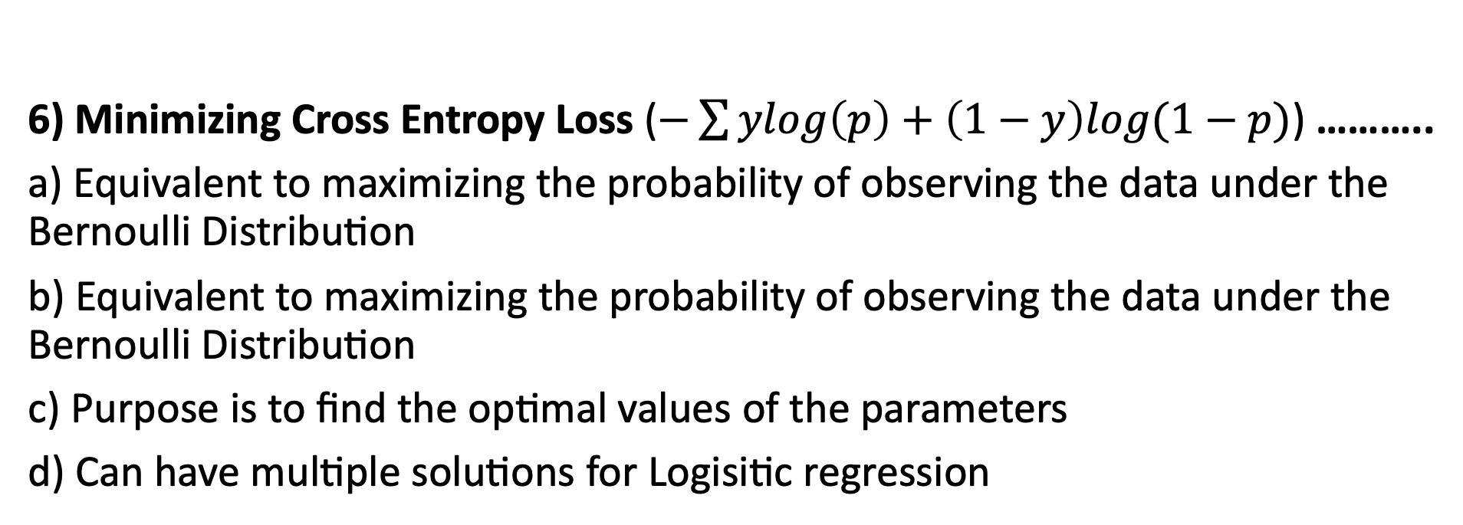
Pop Quiz
6) Minimizing Cross Entropy Loss ($−\sum{ylog\left(p\right)+\left(1−y\right)log(1−p)}$) ………..
a) Equivalent to maximizing the probability of observing the data under the Bernoulli Distribution
b) Equivalent to maximizing the probability of observing the data under the Bernoulli Distribution
c) Purpose is to find the optimal values of the parameters
d) Can have multiple solutions for Logisitic regression

Slide 9
Quiz Notes

Slide 10
Quiz Notes
1) Which of the four types of the classifiers has an inference cost proportional to the size of the training data?
Naïve Bayes
Logistic Regression
Support Vector Machine
K-Nearest Neighbors

Slide 11
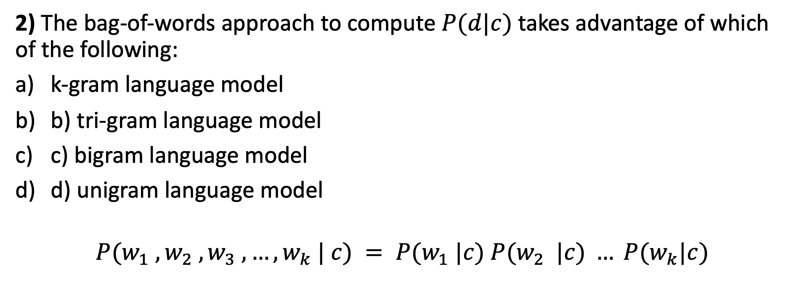
Quiz Notes
2) The bag-of-words approach to compute $P(d|c)$ takes advantage of which of the following:
k-gram language model
b) tri-gram language model
c) bigram language model
d) unigram language model
$$P(w_{1} , w_{2} , w_{3} , …, w_{k} | c) = P(w_{1} |c) P(w_{2} |c) … P(w_{k}|c)$$

Slide 12
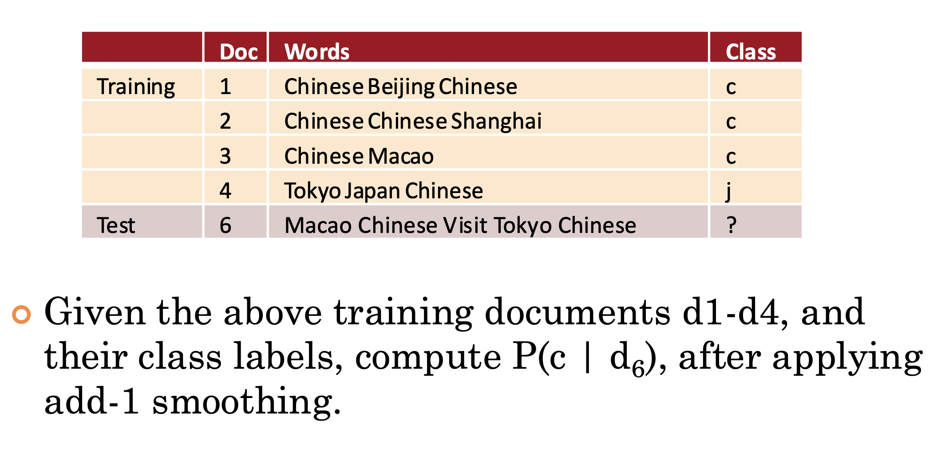
Quiz Notes

Slide 13
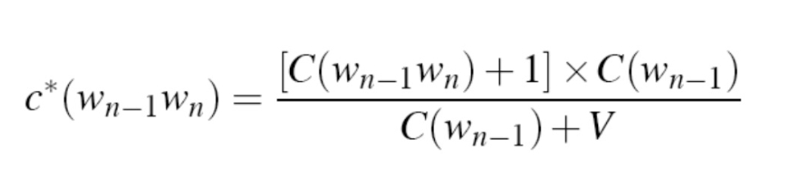
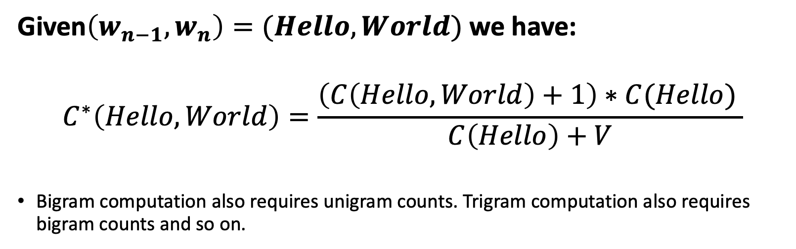
Quiz Notes
Given$\left(w_{n−1}, w_{n}\right)=(Hello, World)$we have:
$$C^{∗}\left(Hello, World\right)=\frac{\left(C\left(Hello, World\right)+1\right)∗C(Hello) }{C\left(Hello\right)+V}$$
Bigram computation also requires unigram counts. Trigram computation also requires bigram counts and so on.

Slide 14
Thank You

